Slide 1

AML Project
Sign Language Video to Text Translation

Slide 2
Overview
Problem Setting
Background
Our approach
Sliding Window
Transformer
Evaluation
Vocabulary
Results
Discussion

Slide 3
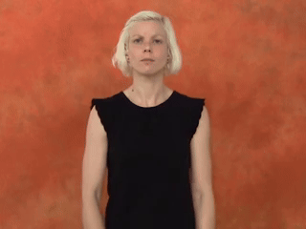
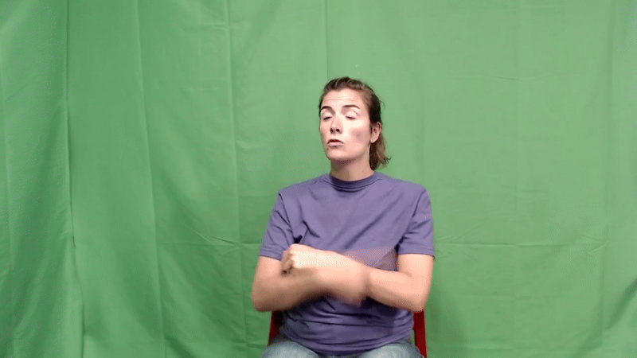
Problem Setting: Goal
Illness
Today we’re going to talk about how to diagnose an illness of you fish.
Notes:
ROHAM SLIDE

Slide 4
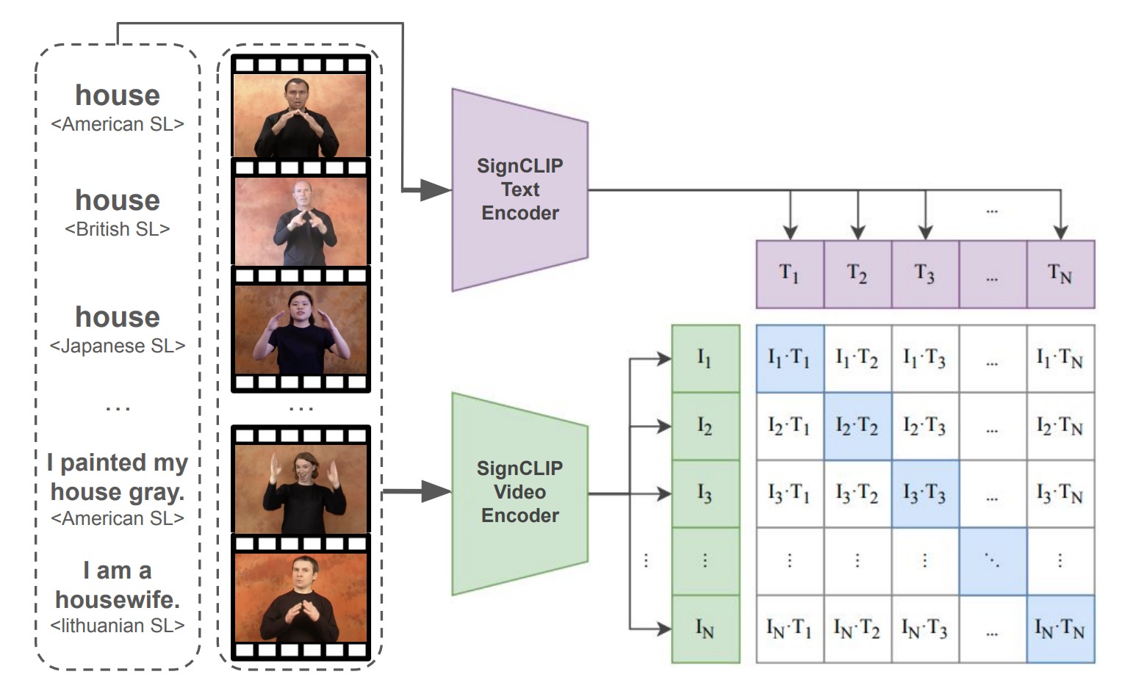
Background: SignCLIP
Multimodal model connecting sign language videos and text via contrastive learning
Pretrained on SpreadTheSign (500k+ video-text pairs in 41 sign languages)
Uses a text encoder (BERT-based) and a video/pose encoder
Fine-tuned on 3 ASL datasets for isolated sign recognition
We use its best checkpoint for sentence-level inference
Jiang, Zifan, et al. "Signclip: Connecting text and sign language by contrastive learning." arXiv preprint arXiv:2407.01264 (2024).
https://arxiv.org/pdf/2407.01264
Notes:
ROHAM SLIDE

Slide 5
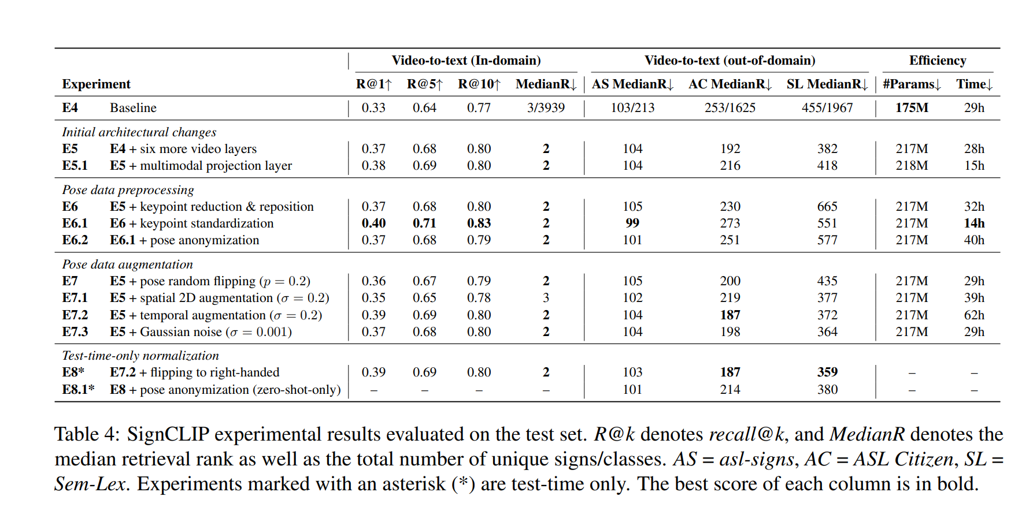
Background: SignCLIP
FingerCLIP (fingerspelling) performs strongly as a proof-of-concept
SignCLIP achieves robust in-domain performance
Correct sign is included in top-10 candidates in 80% of cases (R@10 ≈ 80%)
Strong retrieval accuracy even without fine-tuning
Notes:
ROHAM SLIDE

Slide 6
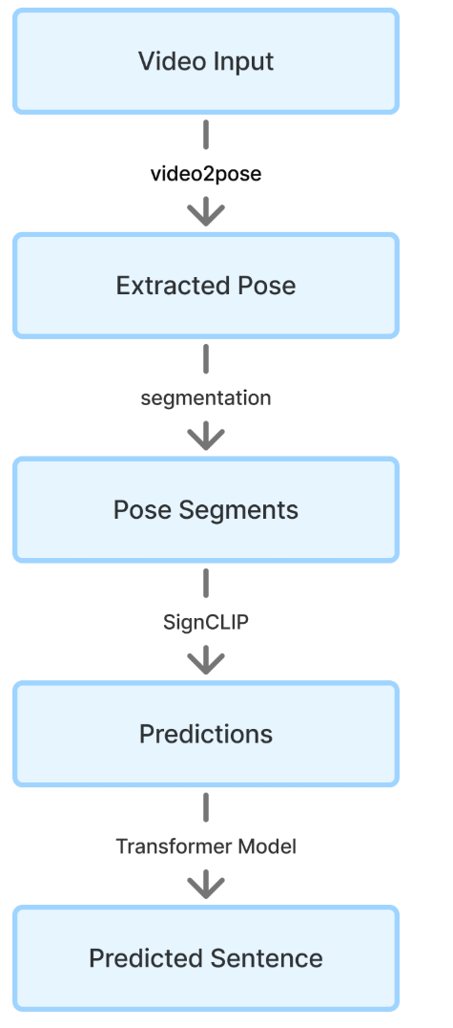
Our approach: Pipeline
Folder with videos
Generate poses with `video_to_pose` CLI tool
Pose data are Tensors with `frames` dimensions → Segmentation doable → mp4 segmentation done for sanity check
SignCLIP creates embeddings for each segmented pose
SignCLIP creates embeddings for our vocabulary
The dot product of embeddings is calculated
Top `K` results are taken for each pose
Softmax applied
Results passed on to Transformer for sentence generation
Store sentences in for evaluation & comparison

Slide 7


Vocabulary
BERT-based word vocabulary
English only (removed non-english)
Removed symbols, prefixes and suffixes
Case-insensitive
How2Sign word vocabulary
From the HowToSign dataset
Extracted from How2Sign sentence annotations
SpreadTheSign gloss vocabulary
Collected via web scraping from SpreadTheSign
Includes both single words and sentence-level glosses
The best performing vocab
Reimers, Nils, and Iryna Gurevych. "Sentence-bert: Sentence embeddings using siamese bert-networks." arXiv preprint arXiv:1908.10084 (2019).
Duarte, Amanda, et al. "How2sign: a large-scale multimodal dataset for continuous american sign language." Proceedings of the IEEE/CVF conference on computer vision and pattern recognition. 2021.
Hilzensauer, Marlene, and Klaudia Krammer. "A multilingual dictionary for sign languages:" spreadthesign"." ICERI2015 Proceedings. IATED, 2015.

Slide 8
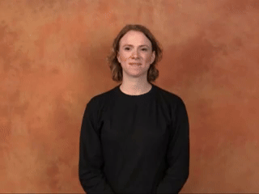
Our approach: Sliding Window
Assumptions:
Glosses are separable
Longer sentences can be sliced up into smaller segments and individually translated
Each segment can be embedded and scored
Combine afterwards
Example: [“I”, “painted”, “my”, “house”, “gray”]
label_1 | score_1 | label_2 | score_2 | label_3 | score_3 | label_4 | score_4
mountain-tour | 85.942635 | indoor climbing | 83.17122 | mountain hiking | 82.94487 | I painted my house gray. | 82.02888

Slide 9
Our approach: Transformers
Divide video into overlapping pose segments (windows with strides)
For each segment, extract top-k gloss candidates from SignCLIP
Use beam search combining:
SignCLIP similarity scores (semantic relevance)
LM log-probabilities (language fluency)
Score beams with optional adjustments (length norm, coverage, uncertainty)
Merge segments to form full sentence, optionally refined by LM

Slide 10
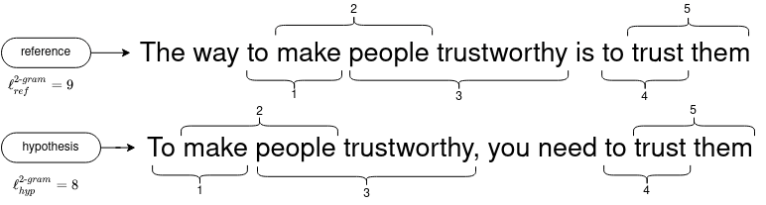
Our approach: Evaluation
ROUGE-1: Unigram (single word) overlap between hypothesis and reference.
ROUGE-L: Measures the longest common subsequence (LCS) — captures in-order matching words.
NLTK BLEU: Weighted geometric mean of 1-gram to 4-gram overlaps between the hypothesis and reference.
TF-IDF Cosine: Convert sentences to TF-IDF vectors calculate cosine similarity.
https://clementbm.github.io/theory/2021/12/23/rouge-bleu-scores.html
Notes:
Uros

Slide 11
Results:
Window Size | Stride | Beam Size | K | BLEU | ROUGE-1 | ROUGE-L | Cosine
8 | 8 | 1 | 10 | 0.03 | 9.20 | 7.27 | 7.66
16 | 8 | 1 | 10 | 0.05 | 9.12 | 7.16 | 8.41
16 | 8 | 10 | 10 | 0.00 | 9.28 | 7.02 | 7.97
16 | 16 | 1 | 10 | 0.00 | 9.56 | 7.45 | 6.99
32 | 16 | 1 | 10 | 0.04 | 9.59 | 7.26 | 7.53
64 | 32 | 1 | 10 | 0.09 | 8.31 | 6.47 | 6.18
Scores are ranged from 0 to 100 (100 means perfect score)
Notes:
Uros subset of how to sign

Slide 12
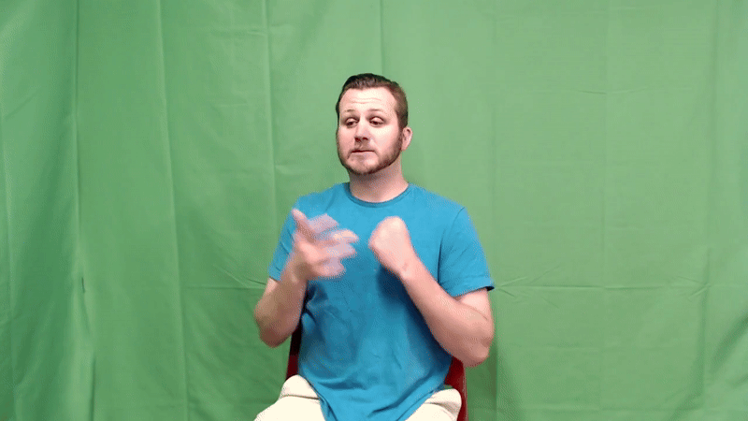
Discussion: Results
“technique”
label_1 | score_1 | label_2 | score_2 | label_3 | score_3 | label_4 | score_4 | label_5 | score_5
How much is a ticket to _____? | 79.118515 | How much does the book cost? | 78.1632 | ticket purchase | 78.00283 | exercise book | 77.90515 | fart | 77.5795
label_6 | score_6 | label_7 | score_7 | label_8 | score_8 | label_9 | score_9 | label_10 | score_10
common failure | 77.50773 | freestyle letter | 77.411385 | recipe card | 77.39789 | bread knife | 77.3272 | unleavened bread | 77.29876
Notes:
Uros

Slide 13
Discussion: SignClip Limitations
Mostly word level glosses but some short sentences included
“I painted my house gray”
Limited to certain length of frames
Training data is very clean and
Dataset small and multilingual
~500 thousand video clips
44 sign languages
Performance
label_1 | score_1 | label_2 | score_2 | label_3 | score_3 | label_4 | score_4
mountain-tour | 85.942635 | indoor climbing | 83.17122 | mountain hiking | 82.94487 | I painted my house gray. | 82.02888
Notes:
Uros

Slide 14
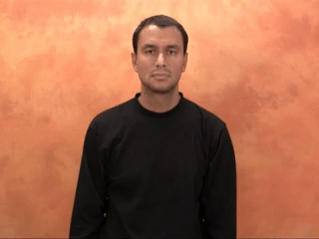
Discussion: SignClip performance
SignClip does not perform well
e.g. “illness’’, “technique”
top scores for our data is silly
label_29 | score_29 | label_30 | score_30 | label_31
research objectives | 76.799286 | spiritual intelligence | 76.69641 | illness
label_1 | score_1 | label_2 | score_2 | label_3 | score_3 | label_4 | score_4
skill | 80.18192 | skillful | 77.71532 | handbook | 77.15087 | talent | 77.13143
Notes:
Uros

Slide 15
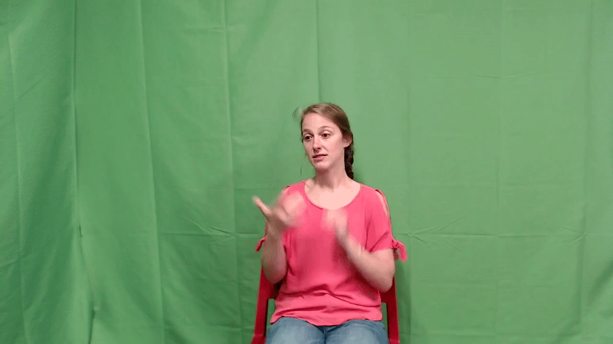
Discussion: Sign Language Segmentation
Sign language is continuous
Variety of speed and length
Training vs. inference quality
Notes:
Uros

Slide 16
Conclusion
Dataset discrepancies
Glosses vs. text
Training on multiple glosses & words
Segmentation problem
Results
Notes:
Uros

